Slide 1
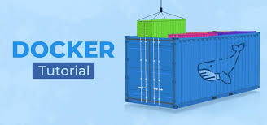
Chapter 3: Docker
By Nguh Prince – tech nerd, guitar enthusiast

Slide 2
Agenda
Containers are NOT VMs
Working with Docker (Build, Ship, Run)
Docker Container Architecture
Multi-container applications
Where to go from here?

Slide 3
Containers are not VMs
Containers vs Virtual Machines (application vs hardware virtualization)
Notes:
Demo Tutum and Docker Hub

Slide 4
Docker containers are NOT VMs
Easy connection to make
They are both used in virtualization and isolation. Containers (and docker) are used in application virtualization while VMs are used for hardware or system virtualization.
Fundamentally different architectures
Fundamentally different benefits
Notes:
This is completely understandable, and many people have done the exact same thing when they first started working with Docker. It’s easy to connect those dots as both technologies share some characteristics. Both are designed to provide an isolated environment in which to run an application. Additionally, in both cases that environment is represented as a binary artifact that can be moved between hosts. There may be other similarities, but to these are the two biggest.
The key is that the underlying architecture is fundamentally different between the containers and virtual machines. The analogy we use here at Docker is comparing houses (virtual machines) to apartment buildings (Docker containers).

Slide 5
Docker containers are NOT VMs
Virtual Machines (VMs)
Virtual machines are effectively individual computers that live inside a host machine. Multiple VMs can live in a single host machine
VMs are created by virtualizing the host machine’s underlying hardware (processing, memory and disk).
The hardware is virtualized and split up, with a piece representing a portion of the underlying physical hardware, which a VM can be run on.

Slide 6
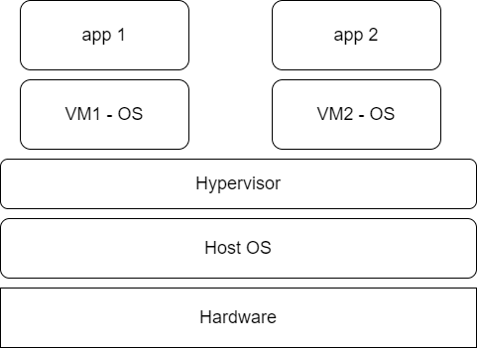
Docker containers are NOT VMs
Notes:
The above image is not entirely accurate. It represents just one type of hardware virtualization (type 2). You could look into type 1 virtualization which effectively removes the need for the host OS, making the solution faster and more sustainable.
But whatever type of virtualization, the concept is effectively the same, the VM is an entirely separate machine on its own.

Slide 7
Docker containers are NOT VMs
Virtual Machines (VMs)
The thing that sits between the VMs and the host is the hypervisor layer. This is software that acts as an intermediary between the VM and the physical host
This makes it computationally expensive to create and run VMs (especially considering the fact that each VM has its own OS and other associated files).

Slide 8
Docker containers are NOT VMs
Containers
VMs suffer from duplication: many of the capabilities and features of the guest OS(s) are found in the host OS, so why not just use the host OS? This is what containers aim to do.
Containers live on top of the host machine and use its resources, instead of virtualizing hardware, they virtualize the host OS.

Slide 9
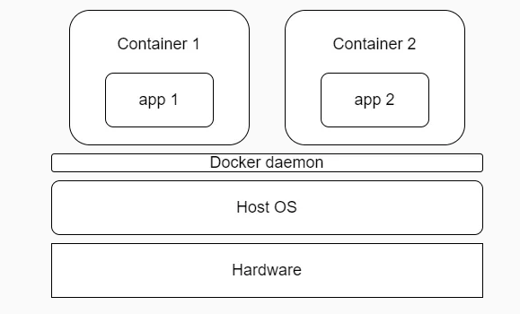
Docker containers are NOT VMs
Notes:
The Docker daemon acts as an intermediary between the Host OS and the container (kind of like the hypervisor)

Slide 10

VMs
A VM is like a standalone house.
Each house (VM) has its own foundation (kernel), plumbing, and electrical system (OS).
Even though all houses exist in the same neighborhood, each house is self-contained and independent—it doesn't share infrastructure with other houses.
If you want to build a new house, you need a new foundation (OS kernel), which takes time and resources.
Notes:
Houses (the VMs) are fully self-contained and offer protection from unwanted guests. They also each possess their own infrastructure – plumbing, heating, electrical, etc. Furthermore, in the vast majority of cases houses are all going to have at a minimum a bedroom, living area, bathroom, and kitchen. It’s incredibly difficult to ever find a “studio house” – even if one buys the smallest house they can find, they may end up buying more than they need because that’s just how houses are built.
VMs are a full copy of an operating system with it’s own dedicated resources. If you decide you need a new house, you build a whole new house – it’s own foundation, plumbing etc. if you want a new VM you deploy a full copy of that environment – the OS, the apps, everything. VMs stand alone, and the leads to duplicating resources – every instance has it’s own full copy of the OS, for instance. Finally the smallest VMs are typically at least hundreds of MBs in size, and they take several minutes to boot up (partially due to the fact that you’re starting a full copy of the OS).

Slide 11
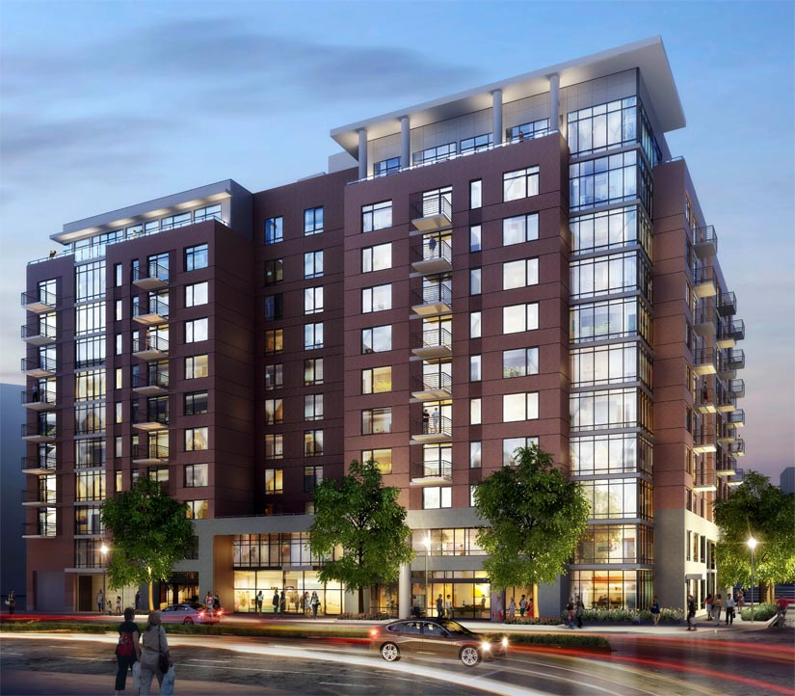
Containers
A container is like an apartment in a building (the host OS).
All apartments share the same foundation (host OS kernel), plumbing, and electrical system, but each unit (container) has its own furniture, decorations, and locks (user-space environment).
Because apartments share the same infrastructure, it's quicker and easier to move in (spin up a container) than building an entire house.
If you need more space, you can quickly rent another apartment rather than build a new house from scratch.
Notes:
Apartments (Docker containers) also offer protection from unwanted guests, but they are built around shared infrastructure. The apartment building (the server running the Docker daemon, otherwise known as a Docker host) offers shared plumbing, heating, electrical, etc. to each apartment. Additionally apartments are offered in several different sizes – from studio to multi-bedroom penthouse. You’re only renting exactly what you need.
Docker containers share the underlying resources of the Docker host. Furthermore, developers build a Docker image that includes exactly what they need to run their application: starting with the basics and adding in only what is needed by the application. Containers are very small (some base OS images are less than 3MBs) start up very quickly (< 3/8s of a second) because you’re not booting a full operating system. You’re just starting a process.

Slide 12
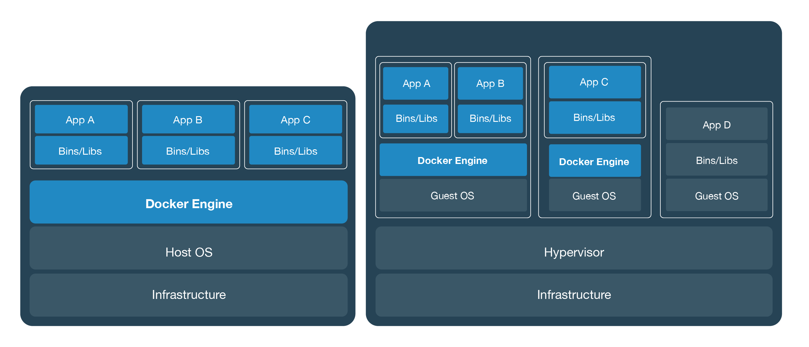
They’re different, not mutually exclusive
Notes:
So if containers are not VMs, a logical question is: Can VMs and Docker containers coexist?
The answer is a resounding “yes.”
At the most basic level VMs (in all their forms) are a great place for Docker hosts to run. Whether it’s a vSphere VM or a Hyper-V VM or an AWS EC2 instance, all of them will serve equally well as a Docker host. Depending on what you need to do, a VM might be the best place to land those containers. But the great thing about Docker is that, it doesn’t matter where you run containers – and it’s totally up to you.
Another question that is often asked relates to whether or not Docker container-based services can interact with VM-based services. Again, the answer is absolutely yes. Running your application in a set of Docker containers doesn’t preclude it from talking to the services running in a VM.
For instance, your application may need to interact with a database that resides in a virtual machine. Provided that the right networking is in place, your app can interact with that database seamlessly.
Another area where there can be synergy between VMs and Docker containers is in the area of capacity optimization. VMs gained early popularity because the enabled higher levels of server utilization. That’s still true today. A virtualization host, for instance, can host VMs that may house Docker hosts, but may also host any number of traditional monolithic VMs. By mixing and matching Docker hosts with “traditional” VMs, sysadmins can be assured they are getting the maximum utilization out of their physical hardware.
One of the most powerful things about Docker is the flexibility it affords IT organizations. The decision of where to run your applications can be based 100% on what’s right for your business. You’re not locked into any single infrastructure, you can pick and choose and mix and match in whatever manner makes sense for you organization. Docker hosts on vSphere? Great. Azure? Sure. Physical servers? Absolutely. With Docker containers you get a this great combination of agility, portability, and control.

Slide 13
Build, Ship, and Run

Slide 14
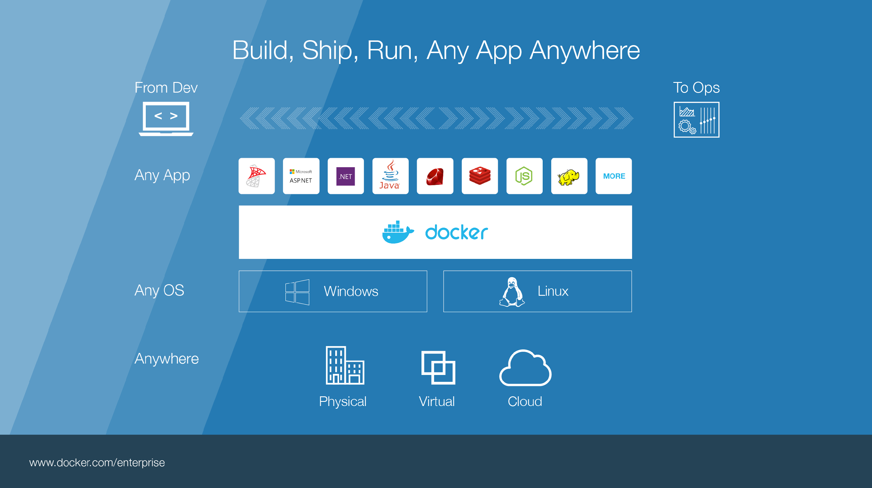

Notes:
Build, Ship, Run – Any App Anywhere – that’s Docker’s slogan
But, what does it mean?
What it essentially boils down to is that developers can choose whatever language or components they want to build their application – .Net, ASP, Java, Ruby, Redis, etc across both the Linux and Windows ecosystem. They are assured that whatever the code up, will run wherever the Ops team chooses to deploy it – Physical, virtual, or cloud – it makes no difference to Docker.
An application written on a developers laptop will run exactly the same on the largest bare metal servers, in the cloud, even on a Raspberry Pi in my den.
Move applications seamlessly from dev to test to production.

Slide 15
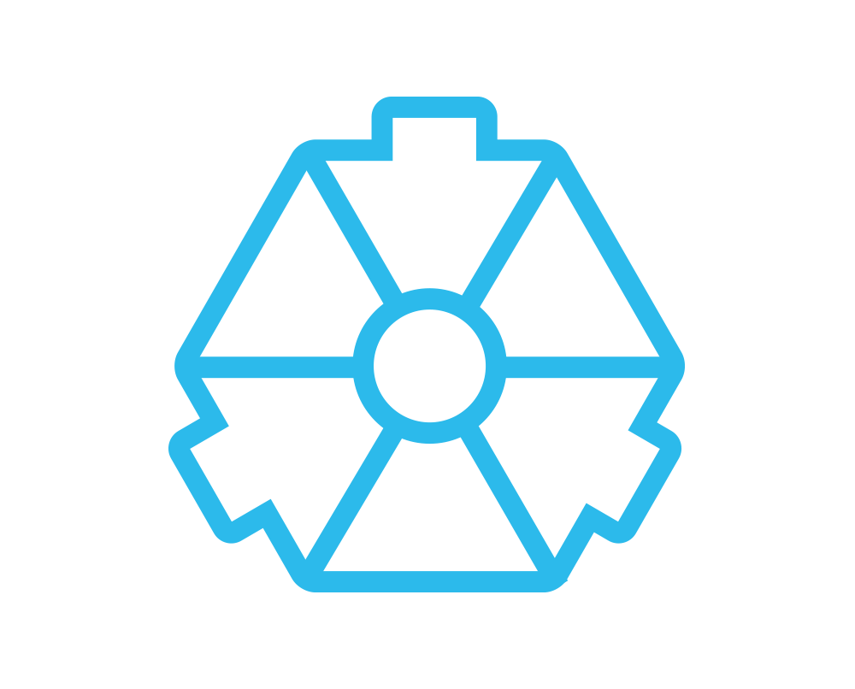
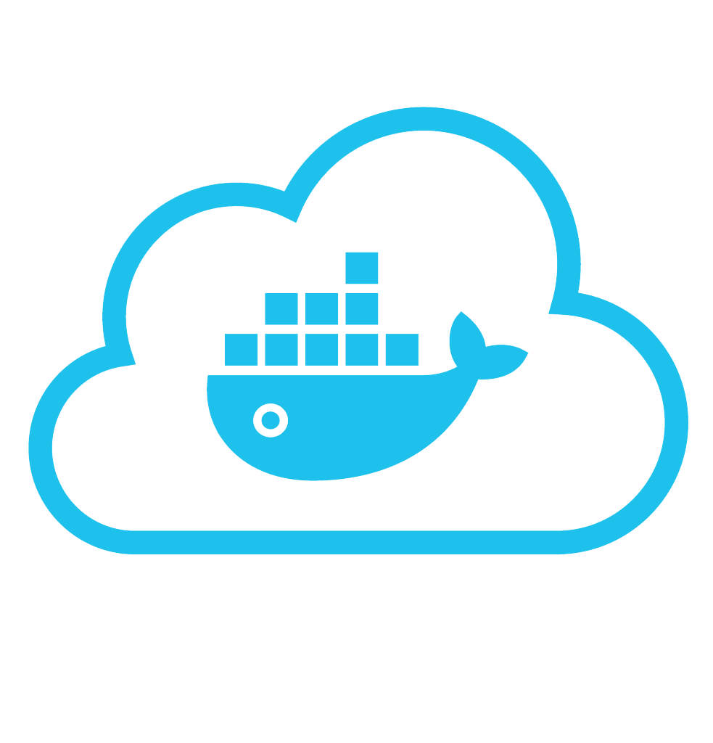
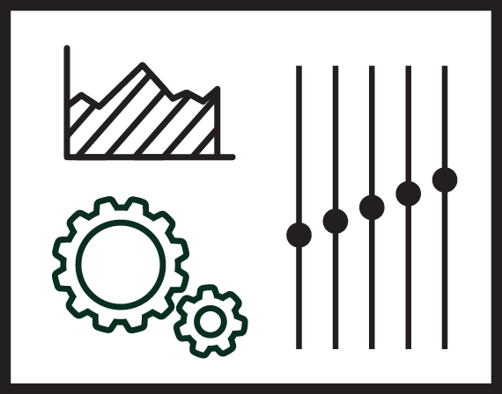


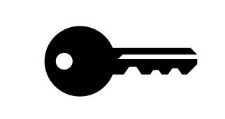
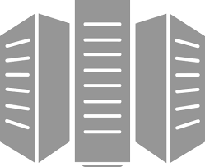
Put it all together: Build, Ship, Run Workflow
Developers
IT Operations
BUILD
Development Environments
SHIP
Create & Store Images
RUN
Deploy, Manage, Scale
Notes:
Local development environments
Self service app images
Build, Test, Deploy applications
Define app behavior and infra needs
Registry services for image storage, management and distribution
IT Ops maintains library of secure base content
Manage role based access to repos/images
Management consoles
Provision, manage infrastructure resources
Monitor, manage, scale infrastructure and applications

Slide 16




Some Docker vocabulary
Docker Image
The basis of a Docker container. Represents a full application
Docker Container
The standard unit in which the application service resides and executes
Docker Engine
Creates, ships and runs Docker containers deployable on a physical or virtual, host locally, in a datacenter or cloud service provider
Registry Service (Docker Hub or Docker Trusted Registry)
Cloud or server based storage and distribution service for your images
Notes:
Let’s take a look at what build, ship run means in a little more detail, but before that we need to level set some Docker vocabulary and commands:
Image
The static component that represents a on-running applicatoin
Containers are derived from images
images contain EVERYTHING an application needs to run
Should always be built via a Dockerfile (which we’ll talk about in a bit_
Container
The standard unit in which the application service resides
Package app and dependencies together
Isolated from other containers
One container per app / service
Docker Engine
The program that creates, ships and runs containers
Deployable on any physical or vm host locally, in datacenters or cloud
Communicates with Docker Hub
Registry
The service that store, distributes and manages container images
Receives commands from Docker Client via Engine
Access control with public, private repos

Slide 17
Basic Docker Commands
$ docker pull gitlab/gitlab-ce:latest # pull a docker registry
$ docker images # list images
$ docker run -d -p 8080:80 -p 443:443 -p 2222:22 --name gitlab gitlab/gitlab-ce:latest # expose ports, the pairs are: host:container
$ docker ps # list running containers, you can also use docker ps –a to list all containers
$ docker stop gitlab (or <container id>)
$ docker rm gitlab (or <container id>) # delete a container
$ docker rmi gitlab/gitlab-ce:latest (or <image id>) # delete an image
$ docker build -t gitlab/gitlab-ce:custom .
$ docker push gitlab/gitlab-ce:custom
Notes:
Docker pull pulls an image from the registry to the local host. This example shows us pulling the 1.0 version of the Catweb image from the mikegcoleman repo on Docker Hub
Docker images will list all the images on your docker host
Docker run will start a new container. In this case we are instructing the docker engine to run the mikegcoleman/catweb image we pulled earlier -d tells docker It should start the application in detached mode (running in the backgorund) and –p 5000:5000 tells docker engine that any requests coming into port 5000 on the host should be directed to port 5000 on this container. –name catweb specifies a name for our running container. If you do not specify a name, Docker will generate one (and they can be pretty funny)
Docker ps shows runing containers. ps –a will show all containers, including ones that have been stopped
Docker stop stops a running container (but does not delete it). You can specify the container name (catweb in our example) or the container ID (every image and container are assigned a unique ID)
Docker rm removes the stopped container. if you specify rm –f you will force docker to remove container even if it’s running. again you can specify the name or ID
Docker rmi removes the specified image
Docker build will create a new image from a docker file. In this example we are creating an image called mikegcoleman/catweb and we’re tagging it with a 2.0 version number. The period says to build the image from the docker file in the current directory. You can explicitly specify a path to your dockerfile if you so choose
Docker push is the opposite of Docker – it pushes an image up to a registry. In this case we’re pushing our newly created docker image up on to hub.

Slide 18
Basic Docker Commands
$ docker save –o gitlab.tar gitlab:latest # save image to a tar file
$ docker load –i gitlab.tar # (loads the image from the file, run this on another machine without the image)

Slide 19
Steps to building a docker image
The main thing needed to build a Docker image is a Dockerfile.
A Dockerfile specifies the parent image, the working directory, some copy commands and a run command
The main sections
Specify parent image
Specify working directory
Copy files from the host to the image
Specify the command to run when the container is started
Notes:
Base images are images that have no parent image – they don’t build on or derive from another image, usually images that represent an operating system (e.g. Ubuntu, busybox).

Slide 20
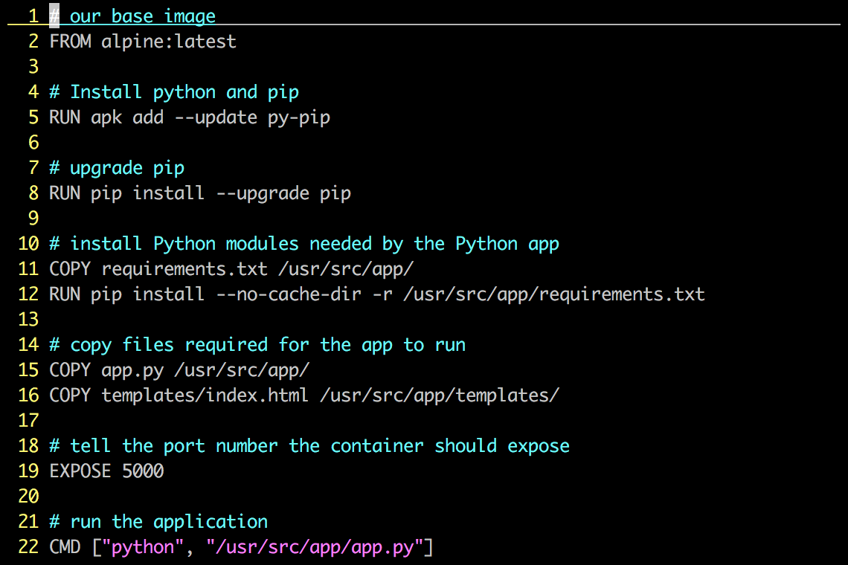
Dockerfile – Linux Example
Instructions on how to build a Docker image
Looks very similar to “native” commands
Important to optimize your Dockerfile
Notes:
A Dockerfile describes how to build a docker image (using the ‘docker build’ command). The commands in the file are a mix of commands you’d actually run to install an application locally (in this case we’re building a python app, and if you’re familiar with Python, you’ll instantly recognize much of what is up on the screen) and specific keywords that tell Docker what to do (RUN a command COPY a file, etc).
An important point about Dockefiles is that they can live with your source code, and be versioned by your version control system. This means Docker images are 100% reproducible. This is another area where VMs and Containers can be different – many times VMs are hand built, and if you lose your golden image you’re out of luck.
This Dockerfile builds a simple flask-based python webapp.
Let’s step through the Dockerfile line by line – note that when the Docker file is processed, all these commands are being run on the Docker image – not your local machine.
Line 1: Build this new Docker image based on the official Apline Linux base image
Line 5: Install Pythong and Pip (the python package manager)
Line 7: use Pip to ensure that Pip is the latest version
Line 11: Requirements.txt holds a list of libraries the app will need, and is used by pip to actually install the library. This line copies the file from your local machine into your Docker image
Line 12: Uses that file and Pip to install the requirements into the container
Line 15: Copy my application code (app.py) into the /usr/src/app directory of the image
Line 16: Copy our index.html file into the /usr/src/app/templates directory of the image
Line 19: The application communicates on port 5000, so we tell Docker to listen on that Port
Line 22: When the container starts up – we fire up Python and pass it out application code to start the app
Again, these steps are pretty much EXACTLY what you would do on a traditional machine to run this application, only here there are being used to create an Docker image.

Slide 21
Image Layers
…
Install Requirements
Copy Requirements
Upgrade Pip
Install Python and Pip
Alpine Linux
Kernel
Notes:
Each action in a docker file creates a new layer in the image.
If we visualize our earlier dockerfile example, you can see the changes in the image that each step created (we only show the first five commands). Images are built from the bottom up, so any change made by a subsequent step, is layered on top of the previous changes already made.
Image layers can be shared between different images. This means that the layers are not duplicated on your Docker host (or on the Registry when they’re pushed). Depending on the underlying filesystem each of these layers is represented by a directory on the Docker host.
You’ll notice if you ever look at a complicated dockerfile that authors will work to put as many commands into a single line by concatenating them together. This is to reduce the numbers of layers in an image.
When you do a docker run command, an additional read / write layer is added to the image. An important point is that even if you started 100 containers, all that is created is 100 Read / Write layers, and they all point back to the read only image on the host.

Slide 22
Docker Container Architecture

Slide 23
What about data persistence?
Volumes allow you to specify a directory in the container that exists outside of the docker file system structure
Can be used to share (and persist) data between containers
Directory persists after the container is deleted
Unless you explicitly delete it
Can be created in a Dockerfile or via CLI
Notes:
One of the tricky things about containers is that when a container is destroyed, that RW layer is removed. Any changes that were made to the container are destroyed in the process.
Clearly this is suboptimal in many cases. For instance you might want to save off some logs from your application or your container was running a database and you want the data to last after the container is destroyed.
The solution to this problem is something called a Volume. A volume is simply a subdirectory in your container that is mapped to a subdirectory that lives outside of the directory structure where your images and containers are stored on your docker host.
For instance, let’s say your application writes to /var/logs, and you wanted to save the logs after the container was destroyed.
You would create a new volume, and tell Docker to send any data destined to /var/logs to the directory that is being managed by the volume.
From a docker perspective we don’t really care where your volumes live. It simply needs to be on storage that is accessible by the Docekr host operating system.
You can create volumes at build time through the dockerfile or at run time via command line switch.

Slide 24
Managing docker volumes
From the CLI
First create the volume
$ docker volume create myvolume
Then attach the volume to a container when running the container
$ docker run -d --name mycontainer -v myvolume:/data myimage
To define a volume in a Dockerfile, just add this line to it VOLUME [“/data”]
Notes:
One of the tricky things about containers is that when a container is destroyed, that RW layer is removed. Any changes that were made to the container are destroyed in the process.
Clearly this is suboptimal in many cases. For instance you might want to save off some logs from your application or your container was running a database and you want the data to last after the container is destroyed.
The solution to this problem is something called a Volume. A volume is simply a subdirectory in your container that is mapped to a subdirectory that lives outside of the directory structure where your images and containers are stored on your docker host.
For instance, let’s say your application writes to /var/logs, and you wanted to save the logs after the container was destroyed.
You would create a new volume, and tell Docker to send any data destined to /var/logs to the directory that is being managed by the volume.
From a docker perspective we don’t really care where your volumes live. It simply needs to be on storage that is accessible by the Docekr host operating system.
You can create volumes at build time through the dockerfile or at run time via command line switch.

Slide 25
Walk, Jog, Run
Walk:
Setup your preferred Docker environment
Fire up some prebuilt images (nginx, hello-world, mikegcoleman/catweb)
Jog:
Pick a well documented solution (Wordpress, Jenkins, etc)
Build it for yourself (blogs are your friend)
Run:
Extend one your Walk solution or Dockerize an existing project
Build your own Dockerfiles
Experiment with Docker Compose and Swarm Mode

Slide 26
Docker Compose
Defining and running multi-container Docker applications

Slide 27
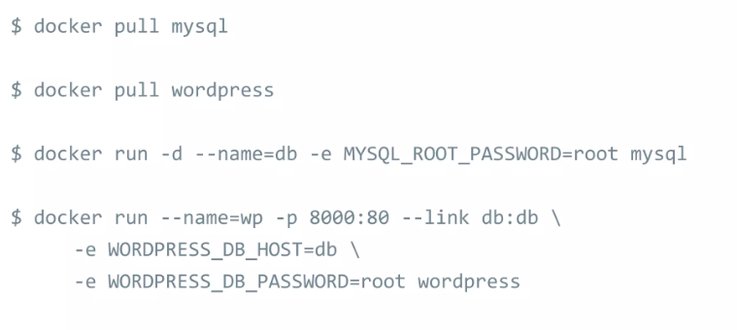
Docker Compose
Multiple container application in Docker

Slide 28
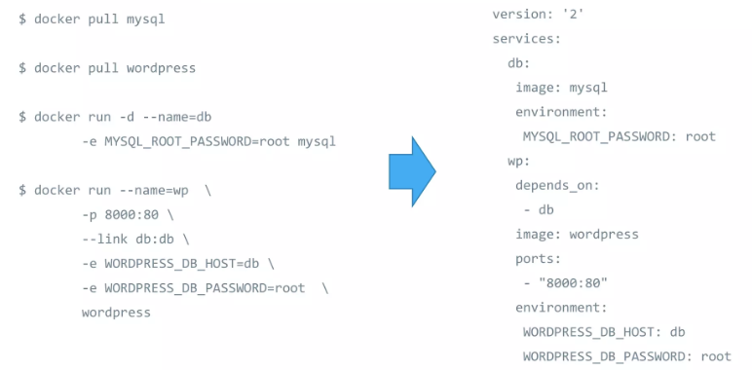
Docker Compose

Slide 29
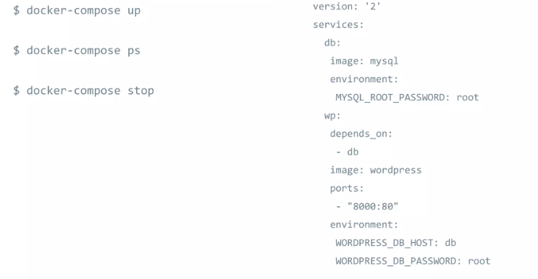
Docker Compose

Slide 30
Where to go from here?
https://github.com/docker/labs
https://prakhar.me/docker-curriculum/

